Slide 1


The Inrodutcion of the ETL team
2018-6-08

Slide 2
Overview
Team leader
Our team has 17 members in all, and it can be divided into four directions roughly .
Deploy
GC countries
Team direction
NGC countries
Big Data and Java

Slide 3
CN name:Yan,Jiapei
EN name:Jiapei
Oversee ORP/DRI ETL changes for both GC and NGC countries in each release.
Guide the Big Data project like EAP, Citi phone planner and so on.
Manager the design of framework and the migration for the ETL server.

Slide 4
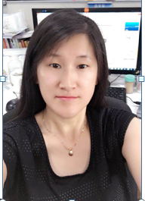
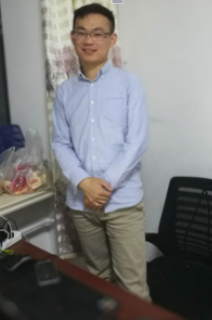

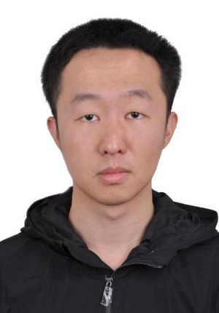
Member of GC Team
CN name:Liang,Cuixia
EN name:Astrid
CN name:Tian,Liang
EN name:Hiro
CN name:Zhang,Junyang
EN name:Patick
CN name:Wang,Zilin
EN name:Zilin
GC ORP ETL developer
GC DRI ETL Developer
Good at Java/Hadoop
GC DRI ETL Developer
Be good at Java
Intern
Do the support for DRI and ORP

Slide 5

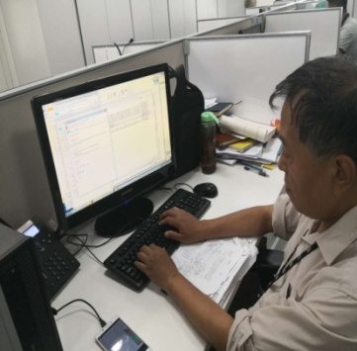


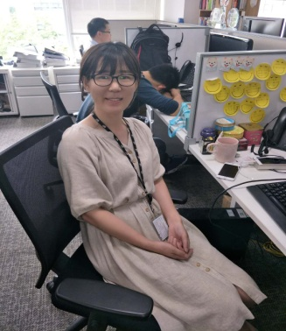
Member of NGC Team
CN name:Dai,Jungang
EN name:Frankie
NGC ETL DEV Lead
CN name:Zhu,Guangming
EN name:Thomas
CN name:Wan,Jing
EN name:Shrelly
EN name:Swathi,Chenareddy
CN name:Li,Yuwei
EN name:Vivian
NGC ETL Developer
NGC ETL Developer
NGC ETL Developer
GFTS Developer

Slide 6


Member of Big Data and Java
CN name:Zhang,Tengyue
EN name:Terrence
CN name:Zhang,Liang
EN name:Warrick
CN name:Xia,Caiyun
EN name:Jackson
Framework Developer
GC ETL Developer
Good at Python
Java Developer
Good at Java

Slide 7



Member of Deploy Team
Deploy lead
CN ame:Yu, Meng
Eg name:Ula
Oversee the deployment work..
Developer
Developer
Name:Wang, Limei
Eg name:May
Intern
Help to deploy the code in UAT and do the
support for the team.
Name:Zhang, Qiaosong
Eg name:Sally
Help to deploy the code in UAT and do the
and Pro.
Help to promote the Autosys code
In Pro.

Slide 8

Others
CN name:Xiao,Liping
EN name:Zoe
Be responsible for the ADL project.

Slide 9

Thank You

